Slide 1
Programming 4 - Intermediate Architecture
and Algorithms
More Python
Semester 1, 2019

Slide 2
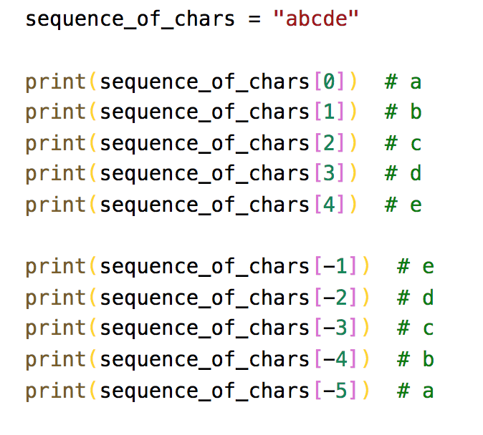
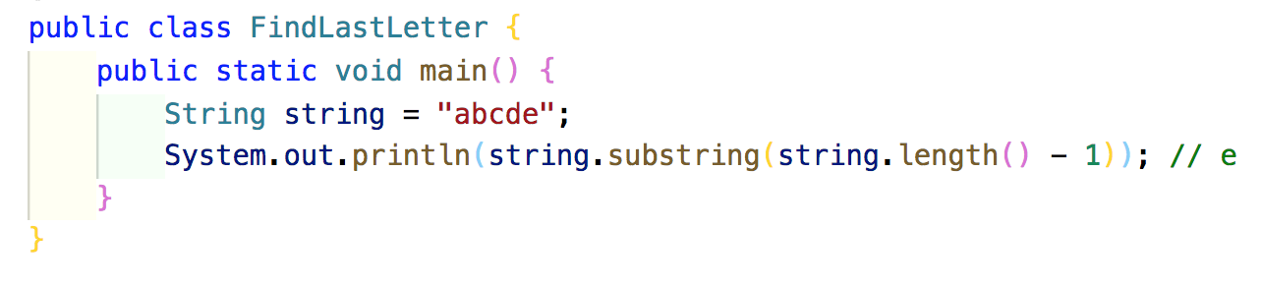
Sequences
Ordered sets
Powerful operation on sequence types
Basic indexing example:
Notes:
Ordered sets are in other languages, we just call them arrays or lists
Python has a very powerful set of special sequence data structures and operations
Slicing is a super powerful operation for array/sequence indexing
In Python, arrays don’t quite work the same as other languages like C# and Java but we are going to look at slicing on the most fundamental sequence type of all – the string
Strings are zero-indexed but we also have negative indexing to count in from the end
Strings are not zero-indexed from the end
You can easily write a program in other language to get the last character of a string but Python makes it much easier
The designer of Python decided that slicing is important that it needs to be primitive
Anyone who wants to build a Python interpreter has to build this in

Slide 3
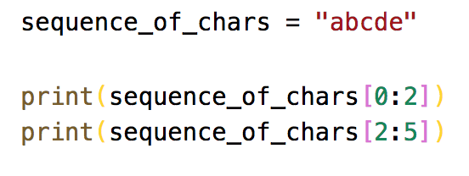
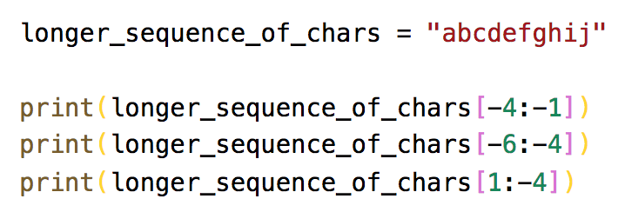
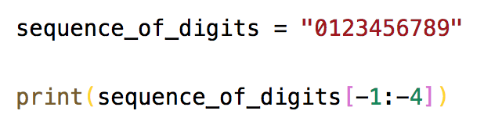
Slicing
More complex indexing option
Start is include and end is exclusive
Negative index slicing
Good for stripping strings
Check for empty strings

Slide 4
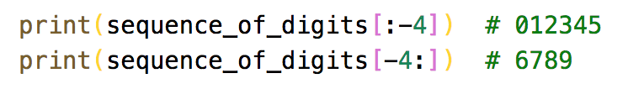
Omitting an index
Means “all”
[start:] – from start (inclusive) to the end
[:end] – from the start to the end (exclusive)

Slide 5
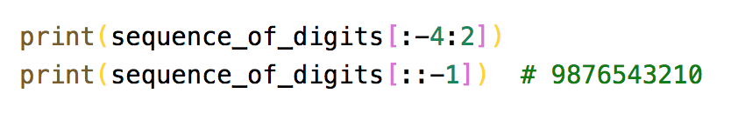
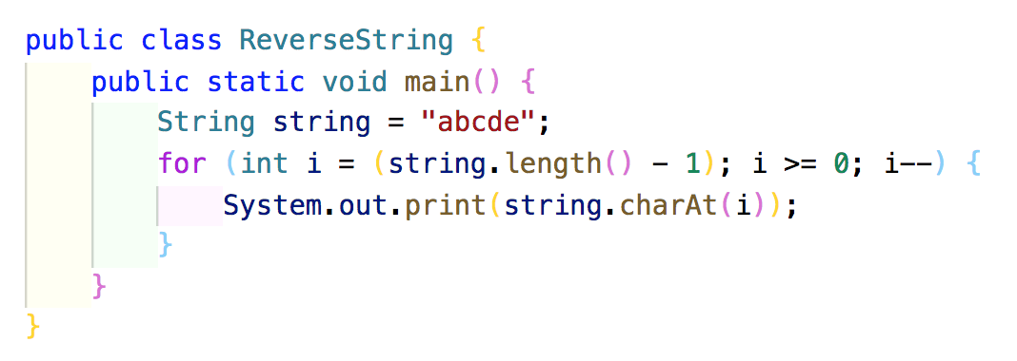
Step
Optional 3rd argument
[start:end:step]
Start and end must describe a right-to-left slice
Remember…start is inclusive and end is exclusive
Excellent way to reverse a string

Slide 6
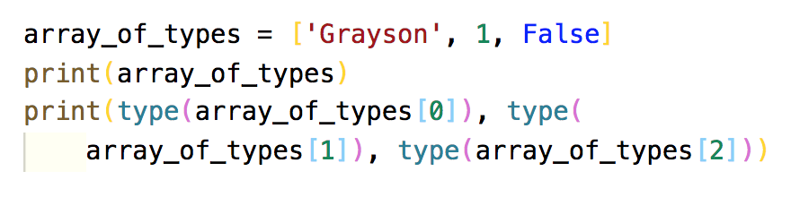
Sequence types
Lists – []
Tuples – ()
Dictionaries – {}
Lists are mutable
Tuples are immutable
Dictionaries are key: value pairs
Notes:
Lists and tuples are both ordered collections of elements
Mutable can be changed after creation
Immutable can’t be changed after creation

Slide 7
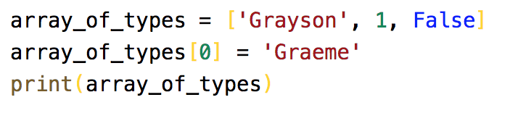
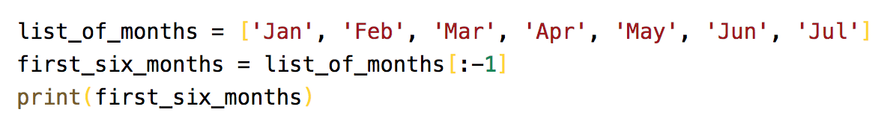
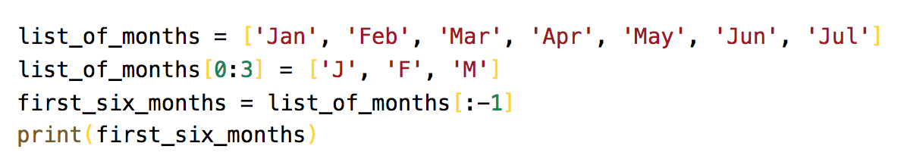
Lists
Indexed as you would expected
Like strings, you can slice on lists

Slide 8
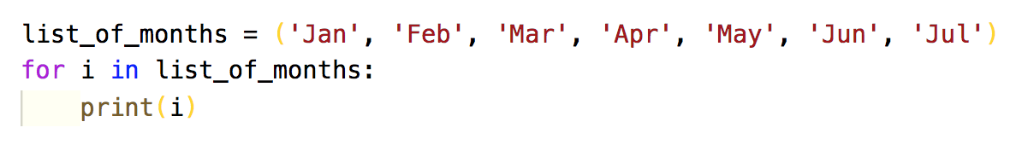
Tuples
Once declared, they can’t be changed
Used like a database record
TypeError: ‘tuple’ object does not support item assignment

Slide 9
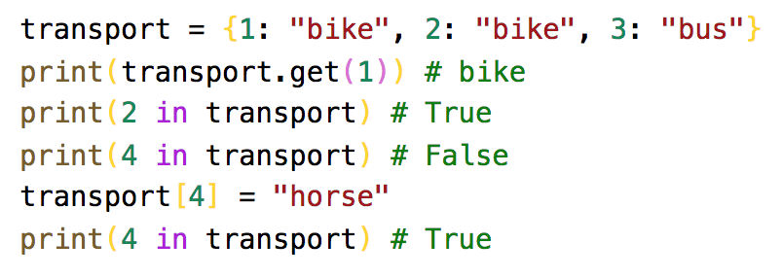
Dictionaries
All languages should have a type of dictionary
They are separated by a colon :

Slide 10
Classes
Declare with class key word
Methods are declared within the code block
All methods have self as the 1st argument
The constructor must be called __init__
Data members:
Are not pre-declared
If created outside any method, they are static
If created inside a method without prefix, they are local to the method
If declared inside a method and prefaced with self, they are class data members

Slide 11
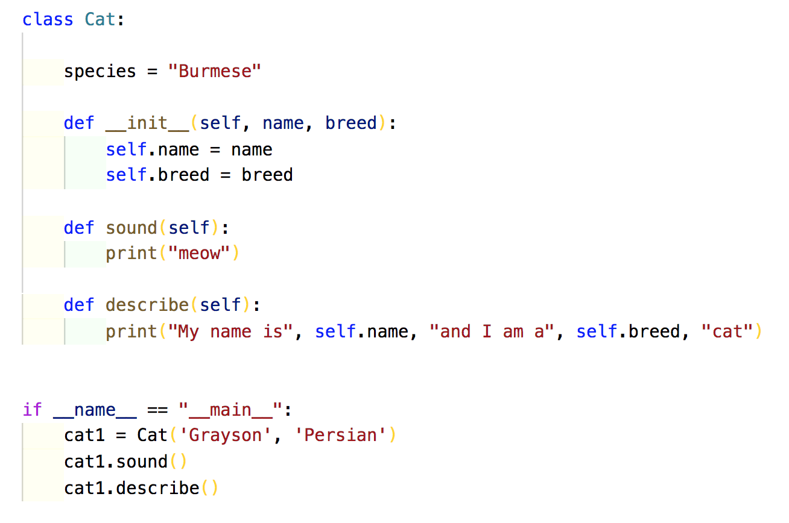
Classes

Slide 12
Ruby assignment
Due on the last day of the semester (21/06/2019)
As promised, I will run through an example

